Slide 1
Chapter 8: Main Memory

Slide 2
Chapter 8: Memory Management
Memory Background
Paging
Structure of the Page Table
Example: The Intel 32 and 64-bit Architectures

Slide 3
Objectives
Describe Memory management functions
Compare physical and logical address
Describe memory allocation techniques
Describe Memory management in Linux and Windows operating systems
To provide a detailed description of various ways of organizing memory hardware
To discuss various memory-management techniques, including paging and segmentation

Slide 4
Memory Definition
Memory can be viewed as a linear array of bytes ranging from 0 to n. Memory is a large array of words/bytes
Every location in memory is identified with an address, represented in hexadecimal system
CPU fetches instructions from memory according to the value of the program counter. The Register can be accessed in one CPU clock (or less)
Main memory can take many cycles, causing a stall (CPU does not have the data needed to complete instruction in execution)
When the system boots, the kernel reserves part of the physical memory to its own text and static data structure. The rest of the memory is managed dynamically
A region’s memory boundaries are configured using two attributes, the starting address and its length, which can be any power of two between 4 KB and 4 GB.

Slide 5
Memory Management Functions
The Operating System must manage all the physical memory and allocate and deallocate it to/from processes.
System services for allocating, deallocating, and managing virtual memory
It manages swapping between main memory and disk, when main memory is not big enough to hold the processes.
Protection of memory is required to ensure correct operation. The operation system assigns to memory regions: access rights and the cache and write buffer policies.
The access to a region in memory is set as read-write, read-only, or no access and is subject to additional rights based on the current processor mode, which is either privileged or user.

Slide 6
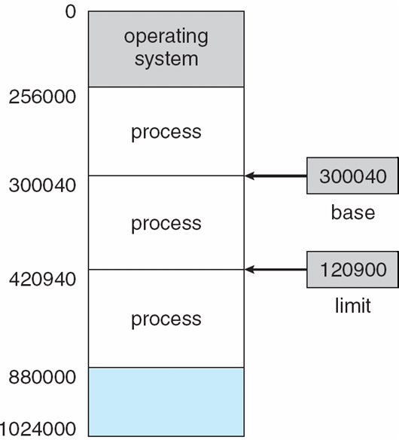
Base and Limit Registers
A pair of base and limit registers define the logical address space
CPU must check every memory access generated in user mode to be sure it is between base and limit for that user.

Slide 7
Binding of Instructions and Data to Memory
Address binding of instructions and data to memory addresses can happen at three different stages:
Compile time: If memory location known a priori, absolute code can be generated; must recompile code if starting location changes
Load time: Must generate relocatable code if memory location is not known at compile time
Execution time: Binding delayed until run time if the process can be moved during its execution from one memory segment to another
Need hardware to support for address maps (e.g., base and limit registers)

Slide 8
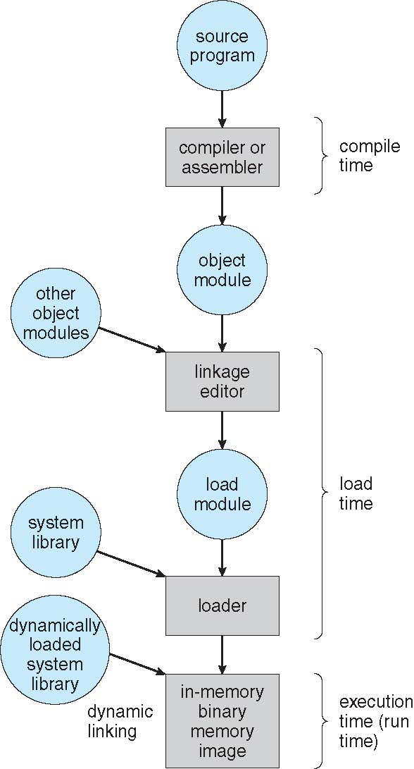
Multistep Processing of a User Program

Slide 9
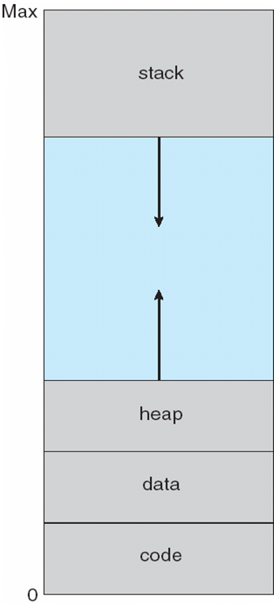
Process-Address Space

Slide 10
Process Address Space
http://duartes.org/gustavo/blog/post/anatomy-of-a-program-in-memory/

Slide 11
The STACK
The Stack is an area of RAM where a program temporary stores during execution time the following:
1. Local variables,
2. Function’s parameters
3. Return addresses of a function
The stack grows toward lower addresses.
The stack operates as LIFO (last in, first out ).
If the area allocated to the stack is not large enough, the executing code will write outside the stack and an memory overflow situation will occur. Stack buffer overflow is a common security vulnerability
If the stack buffer is filled with data supplied from an untrusted user then that user can corrupt the stack in such a way as to inject executable code into the running program and take control of the process.
Underestimating stack usage can cause runtime errors such as overwritten variables, corrupted return address, pointers errors. These errors can be difficult to detect

Slide 12
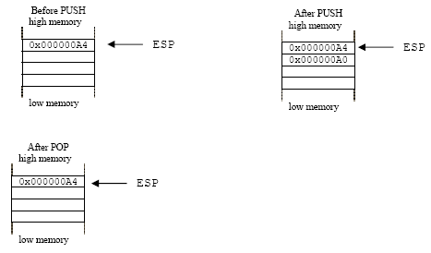
The stack
Push and Pop stack operations
ESP – CPU register -Stack Pointer

Slide 13
Gdb debugger and the Stack
Gdb commands that can be used to display program stack are:
(gdb) bt (backtrace) Displays the program stack
(gdb) frame Shows all stack frames
(gdb frame n Sets current stack frame to <frame-num>
(gdb) where Shows stack: sequence of function calls executed so far
(gdb) break <line> Sets breakpoint at line number <line>
(gdb) break <func-name> Sets breakpoint at beginning of function <func-name>
(gdb) break main Sets breakpoint at beginning of program
(gdb) info frame # list information about the current stack frame
(gdb) info locals # list local variable values of current stack frame
(gdb) info args # list argument values of current stack frame
(gdb) info registers # list register values
(gdb) info breakpoints # list status of all breakpoints
ftp://ftp.gnu.org/old-gnu/Manuals/gdb/html_chapter/gdb_7.html

Slide 14
The Heap
The heap is a memory section that is allocated dynamically to processes during runtime. C functions used to manage heap area are:
The malloc() function allocates size bytes and returns a pointer to the allocated memory. The memory is not initialized. If size is 0, then malloc() returns either NULL, or a unique pointer value that can later be successfully passed to free().
The free() function frees the memory space pointed to by ptr, which must have been returned by a previous call to malloc(), calloc() or realloc(). Otherwise, or if free(ptr) has already been called before, undefined behavior occurs. If ptr is NULL, no operation is performed. The free() function returns no value
man malloc()

Slide 15
The Heap
Memory leak can be generated when malloc() is not properly managed. If memory is allocated with malloc() should be released or free() when not using it or if there is not longer reference to it.
Java objects reside in an area called the heap. The heap is created when the JVM starts up and may increase or decrease in size while the application runs. In java JVM allocates Java heap memory from the OS and then manages the heap for the Java application. When an application creates a new object, the JVM sub-allocates a contiguous area of heap memory to store it. An object in the heap that is referenced by any other object is "live," and remains in the heap as long as it continues to be referenced
https://www.youtube.com/watch?v=xDVC3wKjS64&ebc=ANyPxKornic_dWH4GoTAtOD-Z6VdzHfqUYCPvXEVbZsvIzUt7COcgkVQo0Hoty9Y2y762BQr22JMSBQszcJU1v4ucmpLN0UyhQ
Stack Vs Heap https://www.youtube.com/watch?v=_8-ht2AKyH4

Slide 16
Memory Cache
Cache is a small, high speed memory area placed between the processor core and main memory that stores temporary portions of recently referenced main memory.
Access to cache is faster than access to RAM. If the processor needs to access a page, it will check first cache to fetch the instruction.
The processor provides several internal caches and buffers. The caches are used to store both data and instructions. The buffers are used to store things like decoded addresses to system and application segments and write operations waiting to be performed
Often used with a cache is a write buffer—a very small first-in-first-out (FIFO) memory placed between the processor core and main memory. The purpose of a write buffer is to free the processor core and cache memory from the slow write time associated with writing to main memory.
The cache controller is hardware that copies code or data from main memory to cache memory automatically

Slide 17
Cache
When the processor core writes to memory, the cache controller has two alternatives for its write policy:
write back – the cache controller writes data modifications to cache and not update to RAM until absolutely necessary. Consequently, valid cache lines and main memory may contain different data. The cache line holds the most recent data, and main memory contains older data, which has not been updated. When controller writes a value to cache memory, it sets the dirty bit true. If the cache controller detects a dirty cache line, it is automatically written out to main memory.
write-through the cache controller writes data to RAM and cache simultaneously.
One performance advantage a write-back cache has over a write-through cache is in the frequent use of temporary local variables by a subroutine. These variables are transient in nature and never really need to be written to main memory. A local variable that overflows onto a cached stack because there are not enough registers in the register file to hold the variable.

Slide 18
CPU cache
CPU cache: L1 or L2 . The processor looks for the cache line in the following order:
L1
L2
Last level cache
Memory (RAM)
Once the cache line is in L1, the new data is written to it and the line is marked as modified

Slide 19
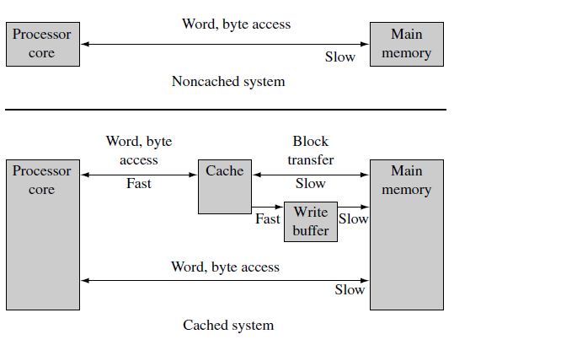
Cache and main Memory Access

Slide 20
Logical vs. Physical Address Space
Memory has two views of addresses :
Virtual (logical) addresses that are assigned by the compiler and linker when locating a program in memory (programmers view).
Physical addresses are used to access the actual hardware components of main memory where the programs are physically located (system view).
The concept of a logical address space that is bound to a separate physical address space is central to proper memory management
Logical address – generated by the CPU; also referred to as virtual address
Physical address – address seen by the memory unit (RAM)
Logical and physical addresses are the same in compile-time and load-time address-binding schemes; logical (virtual) and physical addresses differ in execution-time address-binding scheme

Slide 21
Memory-Management Unit (MMU)
Memory Management Unit (MMU) is a hardware-based memory management unit which converts virtual address of programs and data that are compiled to physical address.
An active region in memory contains code or data in current use by the system; a dormant region contains code or data that is not in current use, but is likely to become active in a short time. A dormant region is protected and therefore inaccessible to the current running task.
Each task is provided its own virtual (logical ) memory map for the purpose of compiling and linking the code and data, which make up the task. A kernel layer then manages the placement of the multiple tasks in physical memory so they have a distinct location in physical memory that is different from the virtual location it is designed to run in.

Slide 22
MMU
To permit tasks to have their own virtual memory map, the MMU hardware performs address relocation. Address relocation is the translation of the address issued by the processor core to a different address in main memory. The translation is done by the MMU hardware
The easiest way to understand the translation process is to imagine a relocation register located in the MMU between the core and main memory.
The MMU simplifies the programming of application tasks because it provides the resources needed to enable virtual memory—an additional memory space that is independent of the physical memory attached to the system.
The ARM processors MMU hardware has multiple relocation registers supporting the translation of virtual memory to physical memory. The MMU needs many relocation registers to effectively support virtual memory because the system must translate many pages to many page frames

Slide 23
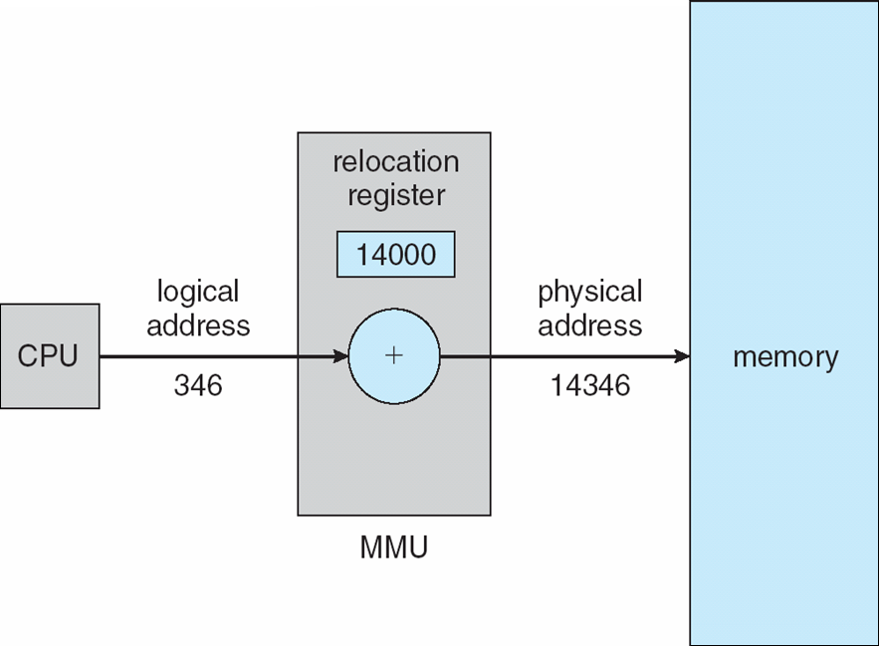
Dynamic relocation using a relocation register

Slide 24
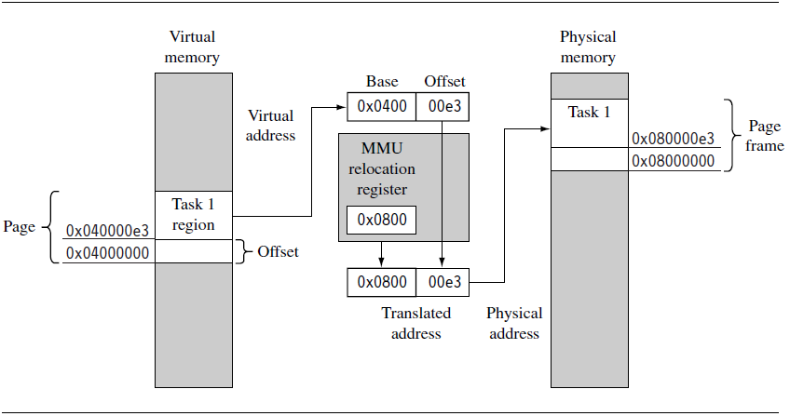
Address Translation and MMU

Slide 25
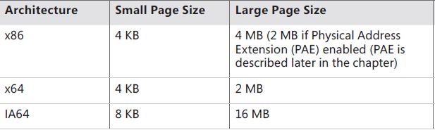
Paging
A single relocation register can only translate a single area of memory, which is set by the number of bits in the offset portion of the virtual address.
This area of virtual memory is known as a page.
The area of physical memory pointed to by the translation process is known as a page frame. Size is power of 2, between 512 bytes and 16 Mbytes. The OS keeps track of frames usage
To run a program of size N pages, need to find N free frames and load program
Pages and respective pages frames are stored in Page Tables
CPU (cores) divides a process into equal size of pages. Usually the page size in most current OS is 4096 bytes = 4KB = 2¹²

Slide 26
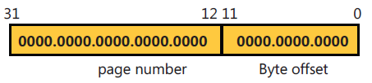
Pages
Address generated by CPU is divided into:
Page number (p) – used as an index into a page table which contains base address of each page in physical memory
Page offset (d) – combined with base address to define the physical memory address that is sent to the memory unit

Slide 27
Page Tables and PTEs
Page Tables contain descriptions of virtual page information. A page table entry (PTE) are organized by virtual address and contains the translation data to map a page in virtual memory to a page frame in physical memory.
A page table is a simple array of PTEs. When many page tables are needed an index to Page Tables is required. The index pointing to each page table will be stored in a Page Directory entry
The virtual address’s page table index field indicates which PTE within the page table corresponds to and describes the data page in question.
A page table entry (PTE) in a page table contains the following information about a virtual page:
the physical base address used to translate the virtual page to the physical page frame,
the access permission assigned to the page, and the cache and write buffer configuration for the page.

Slide 28
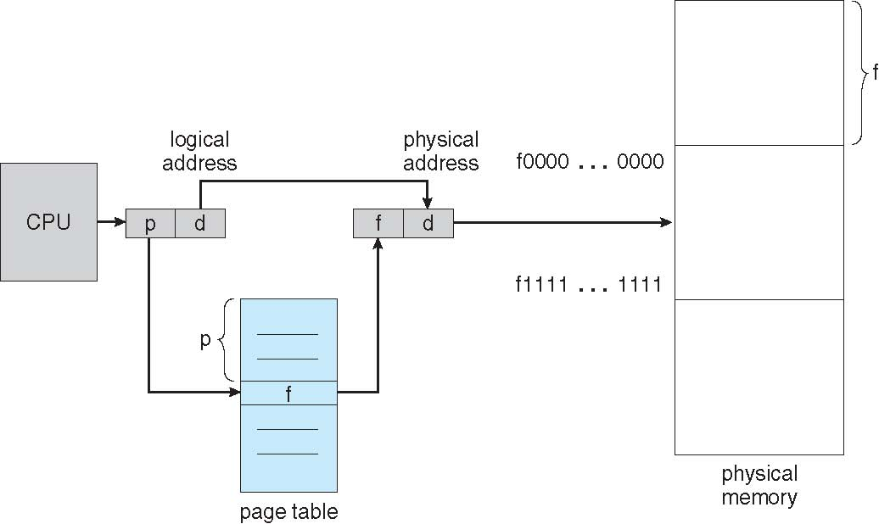
Pages and Page Table

Slide 29
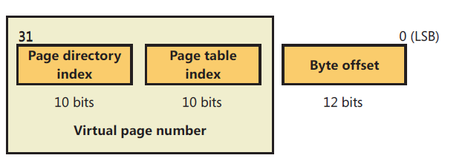
Page Table Structure
The page table index is 10 bits wide, allowing you to reference up to 1,024 4-byte PTEs. Of course, because x86 provides a 4-GB virtual address space, more than one page table is needed to map the entire address space.
To calculate the number of page tables required to map the entire 4-GB virtual address space, divide 4 GB by the virtual memory mapped by a single page table.
Recall that each page table on an x86 system maps 4 MB of data pages. Thus, 1,024 page tables (4 GB / 4 MB) are required to map the full 4-GB address space. This corresponds with the 1,024 entries in the page directory
For example, the byte offset is 12 bits because it denotes a byte within a page, and pages are 4,096 bytes (2¹² =4,096).
The other indexes are 10 bits because the structures they index have 1,024 entries (2¹⁰ = 1,024).
Consider a 32-bit logical address space as on modern computers with Page size of 4 KB (2¹²), the Page table would have 1 million entries (2³² / 2¹²).

Slide 30
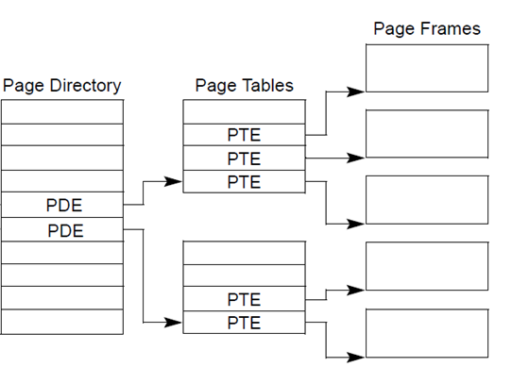
Page Tables structure

Slide 31
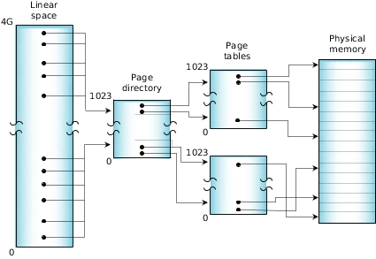
X86 - Two Level Page Table Structure

Slide 32
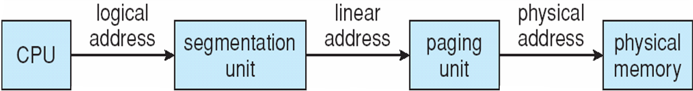
Logical to Physical Address Translation in IA-32
31 22 21 12 11 0
Page table
selector
Page table
entry selector
Byte within page
10 bits
10 bits
12 bits

Slide 33
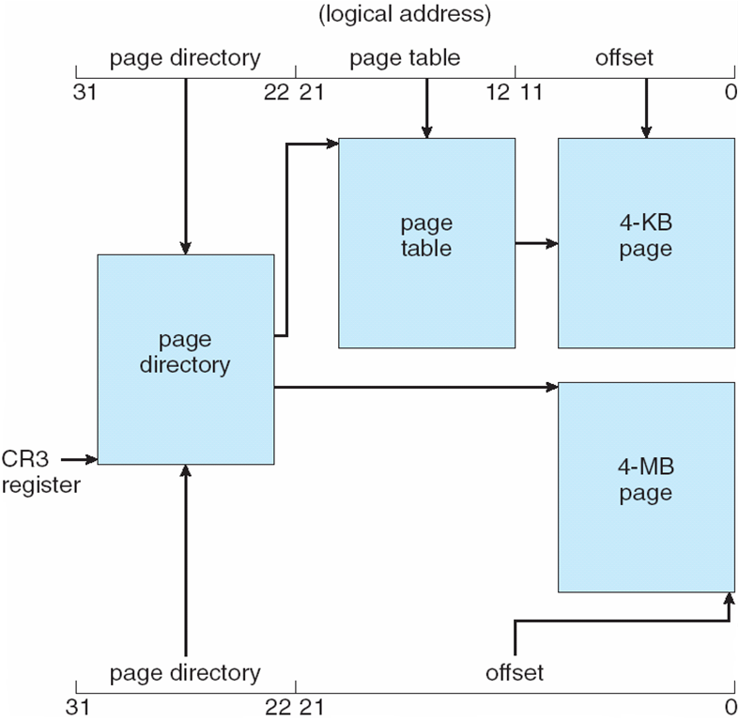
Intel IA-32 Two-Level Page table

Slide 34
ARM MMU and Two Level Page table
The hardware has a multilevel page table architecture. There are two levels of page table: level 1 (L1) and level 2 (L2).
There is a single level 1 page table known as the L1 master page table that can contain two types of page table entry. It can hold pointers to the starting address of level 2 page tables, and page table entries for translating 1 MB pages.
The master L1 page table divides the 4 GB address space into 1 MB sections; hence the L1 page table contains 4096 page table entries. The master table is a hybrid table that acts as both a page directory of L2 page tables and a page table translating 1 MB virtual pages called sections.
If the L1 table is acting as a directory, then the PTE contains a pointer to either an L2 coarse or L2 fine page table that represents 1 MB of virtual memory. If the L1 master table is translating a 1 MB section, then the PTE contains the base address of the 1 MB page frame in physical memory

Slide 35
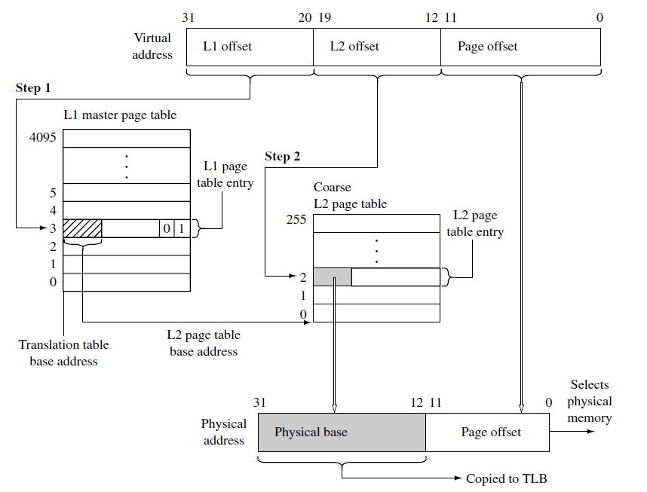
ARM –Two Level Page Table

Slide 36
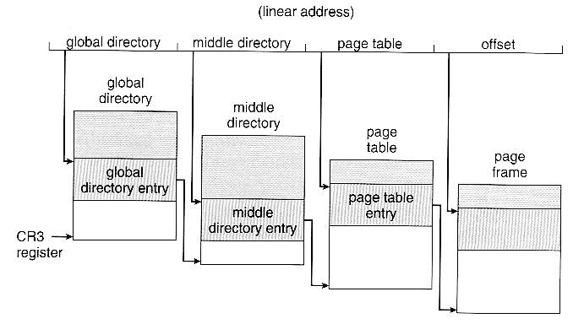
Linux -Three Level Page Table Structure

Slide 37
X64 Virtual Addressing
AMD’s and Intel’s current x64 processors implement only 256 TB of virtual address space. That is, only the low-order 48 bits of a 64-bit virtual address are implemented.
Windows on x64 has limitation: of the 256 TB of virtual address space available on x64 processors, Windows at present allows only the use of a little more than 16 TB. This is split into two 8-TB regions, the user mode, per-process region starting at 0 and working toward higher addresses (ending at 0x000007FFFFFFFFFF), and a kernel-mode, system wide region starting at “all Fs” and working toward lower addresses, ending at 0xFFFFF80000000000 for most purposes.
In practice only implement 48 bit addressing
Page sizes of 4 KB, 2 MB, 1 GB
Four levels of paging hierarchy

Slide 38
64 (Itanium) Virtual Address Space
64-bits = 17,179,869,184 GB
x64 today supports 48 bits virtual = 262,144 GB
IA-64 today support 50 bits virtual = 1,048,576 GB
x64
Itanium
8192 GB
(8 TB)
User
process
space
7152 GB
(7 TB)
User
process
space
6657 GB
System
Space
6144 GB
System
Space
Notes:
7

Slide 39
64-bit ia64 (Itanium) Virtual Address Space
00000000 00000000
User mode space per process
64 bits = 2^64 = 17 billion GB (16 exabytes) total
7152 GB default per-process
Pages are 8 Kbytes
All pointers are now 64 bits wide (and not the same size as a ULONG)
6FC 00000000
Kernel mode
per process
1FFFFF00 00000000
Process page tables
20000000 00000000
Session space
3FFFFF00 00000000
Session space page tables
E0000000 00000000
System space
E0000600 00000000
FFFFFF00 00000000 FFFFFFFF FFFFFFFF
System space page tables

Slide 40
X64-64-bit Page Table Structure
The page map level The base physical address of this page map is stored in CR3.
A set of page directory pointer tables — An entry in a page directory pointer table contains the physical address of the base of a page directory table, access rights, and memory management information.
Sets of page directories — An entry in a page directory table contains the physical address of the base of a page table, access rights, and memory management information.
Sets of page tables — An entry in a page table contains the physical address of a page frame, access rights, and memory management information

Slide 41
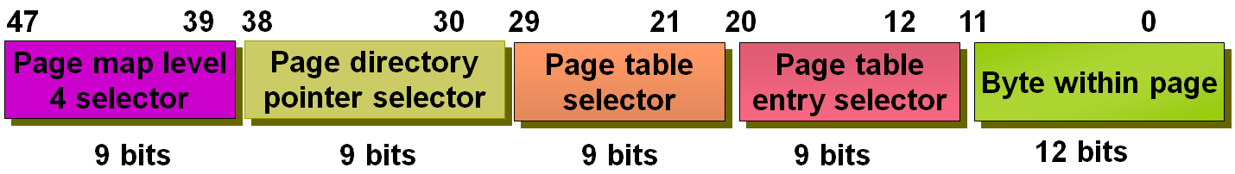
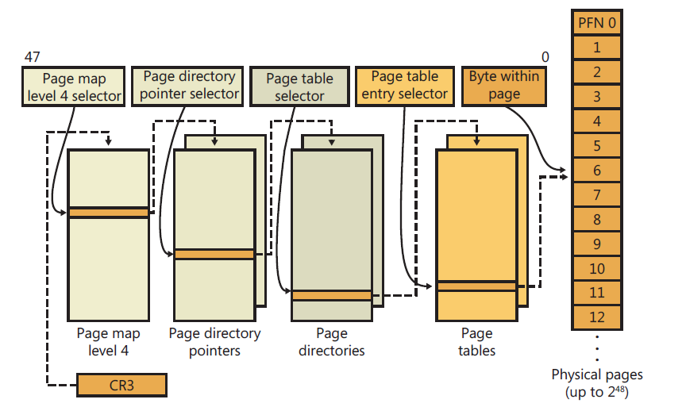
X64-64-bit Page Table Architecture

Slide 42
TLB
The Page table is kept in main memory. Page-table base register (PTBR) points to the page table
In this scheme every data/instruction access requires two memory accesses :One for the page table and one for the data / instruction. When a system requires many pages tables, access to the address translation can take long time. One way to solve the problem is implementing a hardware cache called translation look-aside buffers (TLBs)
The translation look-aside buffers (TLBs) is a special hardware cache implementation that stores recently used page translations.
The TLB maps a virtual page to an active page frame and stores control data restricting access to the page.
TLBs are typically small (64 to 1,024 entries)
On a TLB miss, value is loaded into the TLB for faster access next time
Replacement policies must be considered
In ARM processor cores the TLB uses a round-robin algorithm to select which relocation register to replace on a TLB miss.

Slide 43
TLB hit and miss
During a memory access, the MMU compares a portion of the virtual address to all the
values cached in the TLB.
If the requested translation is available, it is a TLB hit, and the TLB provides the translation of the physical address.
If the TLB does not contain a valid translation, it is a TLB miss. The MMU automatically handles TLB misses in hardware by searching the page tables in main memory for valid translations and loading them into one of the 64 lines in the TLB.
The search for valid translations in the page tables is known as a page table walk.
If there is a valid PTE, the hardware copies the translation address from the PTE to the TLB and generates the physical address to access main memory.
If, at the end of the search, there is a fault entry in the page table, then the MMU hardware generates an abort exception.
During a TLB miss, the MMU may search up to two page tables before loading data to the TLB and generating the needed address translation.
The cost of a miss is generally one or two main memory access cycles as the MMU translation table hardware searches the page tables.

Slide 44

Paging Hardware With TLB

Slide 45
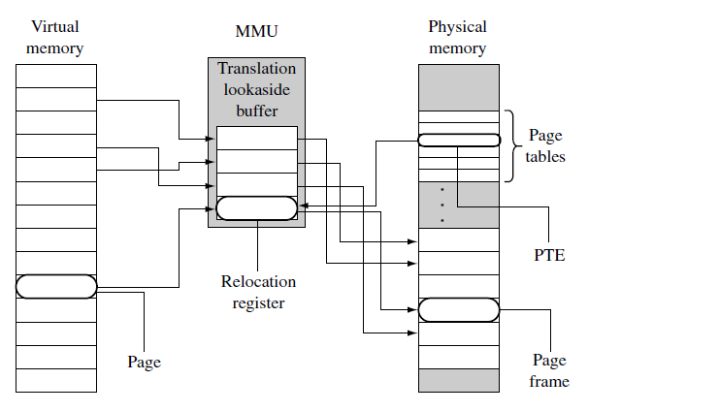
TLB in ARM processors

Slide 46
ARM MMU
The MMU function of ARM processors are to:
read level 1 and level 2 page tables and load them into the TLB
store recent virtual-to-physical memory address translations in the TLB
perform virtual-to-physical address translation
enforce access permission and configure the cache and write buffer

Slide 47
Page Size- Issues
When deciding page size, OS designers must take into consideration the following :
Fragmentation – Internal fragmentation ( wasted space within a page)
Page table size
I/O overhead
Number of page faults
TLB size and effectiveness
Always power of 2, usually in the range 2¹² (4,096 bytes) to 2²² (4,194,304 bytes)

Slide 48
Memory Protection
Memory protection implemented by associating protection bit with each frame to indicate if read-only or read-write access is allowed
Can also add more bits to indicate page execute-only, and so on
Valid-invalid bit attached to each entry in the page table:
“valid” indicates that the associated page is in the process’ logical address space, and is thus a legal page
“invalid” indicates that the page is not in the process’ logical address space
Or use page-table length register (PTLR)
Any violations result in a trap to the kernel

Slide 49

Valid (v) or Invalid (i) Bit In A Page Table

Slide 50
Shared Pages
Shared code
One copy of read-only (reentrant) code shared among processes (i.e., text editors, compilers, window systems)
Similar to multiple threads sharing the same process space
Also useful for inter-process communication if sharing of read-write pages is allowed
Private code and data
Each process keeps a separate copy of the code and data
The pages for the private code and data can appear anywhere in the logical address space

Slide 51
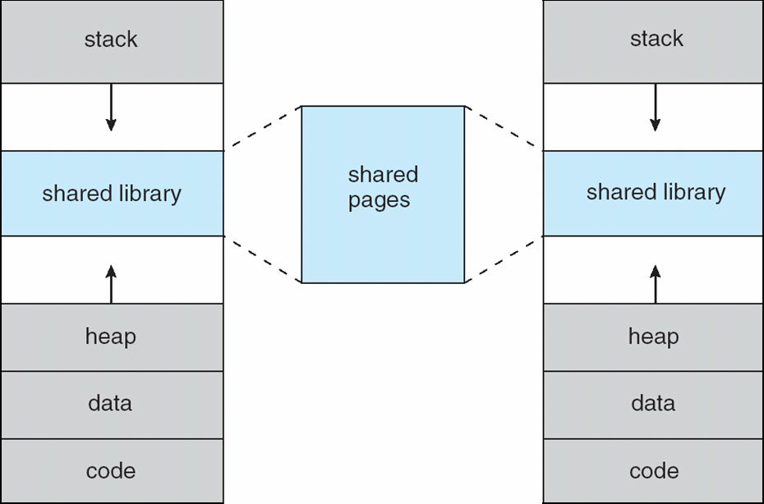
Shared Library Using Virtual Memory

Slide 52
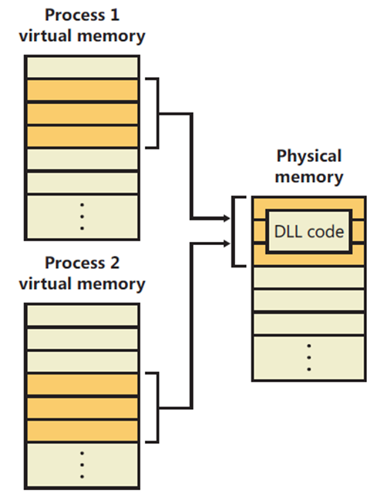
Shared Pages among Windows processes

Slide 53
Linux Memory Management
Access the following web site and read basic concepts of Linux memory management http://www.tldp.org/LDP/tlk/mm/memory.html
How the kernel manages memory
http://duartes.org/gustavo/blog/post/how-the-kernel-manages-your-memory/

Slide 54
References
http://duartes.org/gustavo/blog/post/page-cache-the-affair-between-memory-and-files/
ARM System Development Guide book – Chapter 14 - “Memory Management”
https://www.youtube.com/watch?v=AjTl53I_qzY&list=PLI63-CUdihCrI3eAG2UN6hGR6CiS1yTMV

Slide 55
End of Chapter 8

